Slide 1

Main learning points in lecture “Applied Epidemiological Research for Vaccine Preventable Diseases: Vaccine Effectiveness”
Training of Trainers in Epidemiology of Vaccine Preventable Diseases
Created in February 2012, revised May 2018
Notes:
Facilitator notes:

Slide 2
Objectives
Specific objectives of this session:
Prepare a lecture on applied epidemiological research for vaccine-preventable diseases;
Adapt the lecture to its country target audience by using its own examples;
Understand and calculate vaccine effectiveness (VE) and efficacy;
Describe study designs (RCT, cohort, case-control, house-hold contact, screening) for estimating VE either in clinical trials or in the field;
Understand the potential pitfalls in estimating VE;
Be able to interpret VE estimates
Related to the course objectives:
Ability to lecture on surveillance, outbreak investigation and applied epidemiological research of VPD
Ability to define the target audience and to adjust material/contents
Notes:
Facilitator notes:

Slide 3
Outline
This session consists of the following elements
Background & Definitions
Clinical trials to estimate efficacy
Observational studies to estimate effectiveness
Methodological issues
Herd immunity
Primary and secondary vaccine failure

Slide 4
Background & Definitions

Slide 5
Note for trainers
This presentation is a reference presentation on the topic of applied epidemiological research of vaccine preventable diseases (VPDs), focussed on methods to assess vaccine effectiveness
The target audience for this lecture are epidemiologists working with VPDs on a national or regional level
The lecture can be adapted with your own example data
The hidden slides tagged as “notes for trainers” such as the current slide are meant as a guide for trainers, and should be removed prior to giving the talk
Notes:
Facilitator notes:

Slide 6
Note for trainers
The objective is to demonstrate that applied research is a critical component of evaluating national vaccination programmes
The importance of identifying a clear study question needs to be highlighted
The strengths and weaknesses of the alternative study designs that can be used need to be understood
The potential biases need to be understood
Notes:
Facilitator notes:

Slide 7
Vaccines and vaccine efficacy/effectiveness
Vaccines need to be assessed before and after licensure
Assessment will include safety, cost effectiveness, changes to disease epidemiology & interactions with other vaccines
We will be concentrating on how well the vaccine prevents disease – known as vaccine efficacy or effectiveness

Slide 8
Vaccine evaluation pre and post licensure
Pre-licensing
randomised, blind, controlled clinical trials
Vaccine efficacy:
protective effect under idealised conditions
simple interpretation
Post-licensing
observational studies
Vaccine effectiveness:
protective effect under ordinary conditions of public health programme.
could be affected by cold chain problems/bad batches/poor delivery/use in different populations/changes to disease epidemiology…
prone to bias so interpretation more complex
Notes:
8
Need to highlight the core differences between vaccine efficacy and vaccine effectiveness

Slide 9
Note for trainers
Need to further highlight that VE does not measure the indirect (or herd immunity) effect of vaccination – this is “impact”

Slide 10
Efficacy, effectiveness, impact and herd immunity
Efficacy is the direct protection to a vaccinated individual as estimated from a clinical trial
Effectiveness is an estimate of the direct protection in a field study
post licensure.
Impact is the population level effect of a vaccination campaign.
  This will depend on many factors such as vaccine coverage, herd immunity and effectiveness.
Herd immunity is an indirect effect of vaccination due to reduced
disease transmission.
Notes:
In fact there are two components of vaccine protection - direct and indirect effect.
Direct effect is the prevention of infection by the vaccine in a vaccinated individual
Indirect effect is the effect of the vaccine at the population level. With increasing coverage, there is a fall in the number of cases and thus sources of transmission in a given population and thus a reduction in the risk of infection in the community - so called herd immunity
Measures of VE (i.e. RCT) are usually randomised at an individual level to eliminate the indirect effect and thus measure only the direct effect of the vaccine, whereas effectiveness trials measure both direct and indirect effects with the unit of allocation groups of individuals

Slide 11
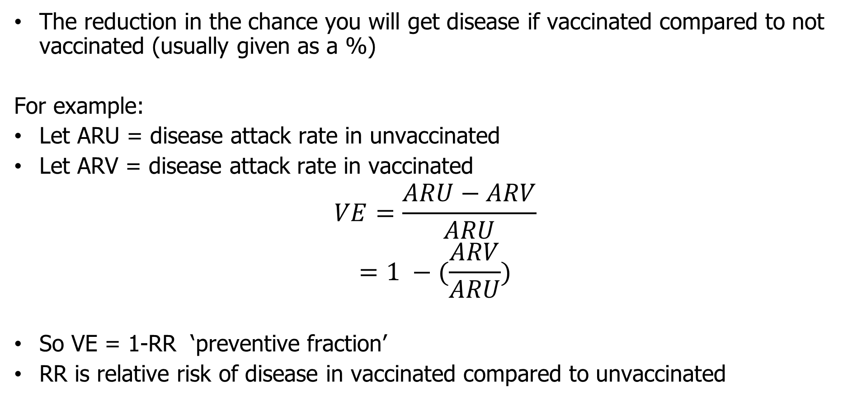
Mathematical definition of vaccine efficacy
The reduction in the chance you will get disease if vaccinated compared to not vaccinated (usually given as a %)
For example:
Let ARU = disease attack rate in unvaccinated
Let ARV = disease attack rate in vaccinated
$$VE=\frac{ARU−ARV}{ARU}$$
$$=1 −(\frac{ARV}{ARU})$$
So VE = 1-RR ‘preventive fraction’
RR is relative risk of disease in vaccinated compared to unvaccinated

Slide 12

Calculation of attack rates
measure of risk: attack rate (AR)
$$=\frac{\left(number of cases\right)}{(number of persons at risk)}$$
measure of rate: incidence density
$$=\frac{\left(number of cases\right)}{(number of person−years at risk)}$$
Notes:
VE can be estimated from both measures of risk and rate:
From risk: this is a measure of the risk or probability of developing disease in the follow-up period.This equals the number of cases divided by the number of persons in the group. This equates with the AR.
From rate:a measure of the average instantaneous incidence rate of the disease in the follow-up period. This equals the number of cases divided by the person years (or time) at risk computed for each individual from entry into the study to the development of disease or the end of the study period. This equates with incidence density.

Slide 13
Note for trainers
For the following slide – ask the group to answer each question quickly (either in pairs or all together)

Slide 14
VE = 1- ARV
ARU
Notes:
14

Slide 15
Clinical trials to estimate efficacy

Slide 16
Estimating efficacy - clinical trials
Gold standard
  Evaluate optimal clinical protection from vaccine in target population (phase 3 trial)
  Compare new vaccine to either placebo or control vaccine
Randomised, double-blind design
  Only difference between individuals is vaccine status
  Control for confounding and bias in study design
  Can randomise individuals or sometimes communities
Issues
  Expensive for rare outcomes (use correlate of protection)
  May not represent population vaccine used on
  Ethical issues
  What to use as comparison group – particular if new formulation or delivery method

Slide 17
Randomised clinical trial
Clinically confirmed cases of pertussis and VE of acellular DTP
(Greco D et al, 1996)
 | No o person-days at risk | No of cases | Incidence / 100,000 person-years
DTP | 2,354,321 | 37
DT | 758,646 | 74
Notes:
This table shows the results of a VE RCT for acellular pertussis vaccine in Italy for clinically confirmed cases of pertussis.
Incidence densities (number of cases divided by number of person days at risk) were calculated for those receiving DTP (vaccinated) and those receiving only DT (unvaccinated).

Slide 18
Note for trainers
For the following slide – ask the group how they would calculate VE (hint – see formula from previous slide)

Slide 19
Randomised clinical trial
Clinically confirmed cases of pertussis and VE of acellular DTP
(Greco D et al, 1996)
VE = 1-RR = 1- 0.56/3.5 = 0.84 (84%)
 | No o person-days at risk | No of cases | Incidence / 100,000 person-years
DTP | 2,354,321 | 37 | 0.56
DT | 758,646 | 74 | 3.5
Notes:
VE was calculated as 1 minus the RR and was 84%.

Slide 20
Observational studies to estimate effectiveness

Slide 21
Estimating vaccine effectiveness in observational studies
cohort study
household contact study
case control studies
screening method (case population)
Notes:
There are several methods to measure VE.
As already mentioned RCT can be used to measure VE (usually prelicensure phase 3a) or vaccine effectiveness (usually phase 4post licensure and increasingly prelicensure phase 3b)
Observational studies are assessments of VE in the field post-licensure, which are often undertaken in outbreak settings.
There are several methods which we will explore. They can be serological and/or epidemiological. Epidemiological methods include the rapid screening or case population method, cohort studies, family contact studies based on calculating household secondary attack rates, case-control methods and cross-sectional mthods such as EPI cluster sampling technique.

Slide 22
Note for trainers
For the following slide – assessment of VE can be made during or after an outbreak using a traditional cohort design. An outbreak is a useful efficient setting to investigate VE as the diseases is more common and exposure to infection tends to be similar for all in the cohort

Slide 23
Cohort Design
Usually retrospective as part of an outbreak investigation or using database such as GP consultation records
Define discrete population at risk (cohort) e.g. school
Obtain vaccination status
Compare risk of disease in vaccinated and unvaccinated groups VE = (1-RR)
If vaccination status changes during the study period then use the person time approach
Key issue: not good for rare diseases as unlikely to have sufficient power or expensive.
Notes:
An assessment of VE can be made during or after an outbreak utilising a traditional cohort design. An outbreak is a useful efficient setting to investigate VE as the diseases is more common and exposure to infection tends to be similar for all in the cohort.
The population at risk needs to be defined - i.e. those with no previous history of disease (susceptible) who were equally exposed to infection. Equal exposure to disease is very important and the assumption is made of random mixing in the community, that the vaccinated and unvaccinated are equally exposed to infection and that pockets of high vaccination coverage are not present which may have reduced exposure to infection.
The vaccination status of the population needs to be determined at the beginning of the outbreak- thus a cohort is created.
The AR in vaccinated and unvaccinated populations are calculated and VE estimated.
If the vaccination status of the population should change during the outbreak, if for example there is a vaccination campaign, then persons initially classified as unvaccinated may become vaccinated, then a person-time approach needs to be used or the analysis should be restricted to cases occurring before the time point of the intervention.

Slide 24
Example – Muhsen et al (Vaccine -2011):
Rotavirus and acute gastroenteritis in children
Used Health maintenance data – comparing attack rates for 2008/09 in children “purchasing” vaccine pre 2008/09 rotavirus season with those who did not.
ARU= 8801/18591 (47.3%)
ARV=1758/7586 (23.2%)
RR = 23.2/47.3 = 0.49
VE = (1-RR) = 0.51 (51%, 95% CI 48%-53%)

Slide 25
Note for trainers
Major concern with population based cohort outbreak investigations is that exposure to disease may be different between the vaccinated and unvaccinated… next study design gets around this problem

Slide 26
Household Contact Design
Useful to ensure that vaccinated and unvaccinated have an equal opportunity for exposure.
Each household with a primary case is a mini-cohort;
Index and primary cases within each household identified
  Identify primary cases
  List all household contacts and identify as secondary, tertiary cases etc.
  With the secondary cases calculate attack rates in vaccinated and unvaccinated individuals. Repeat this within the tertiary cases etc.
  Sum across households to get overall ARs and hence estimate of VE
Key issue: Need detailed data on timing of onsets. Households with more cases maybe more likely to be identified.
Notes:
A major concern with population based cohort outbreak investigations is that exposure to disease may be different between the vaccinated and unvaccinated.
The random mixing assumption of vaccinated and unvaccinated is more likely to be met in small units of population such as families. As it is likely that vaccinated and unvaccinated will be equally exposed to index cases - thus reducing this potential confounding.
Each household is regarded as a minicohort. Index or primary cases within households are identified and their households investigated, so that household contacts are listed. For each generation, cases are classified as co-primary, secondary, tertiary etc according to the intervals between contact with index case and onset of disease.
The at risk population (susceptible) is defined for each generation - by excluding past cases and the index case from each successive generation. These are summed for all households and generations.
The cases within this cohort are then classified according to vaccine status and summed across generations and households. The AR is then determined by vaccination status and the VE calculated.
One potential problem with these studies is that if a provider based surveillance system is used, it is more likely that families with large numbers of cases will be notified, thus biases the VE estimate.

Slide 27
Household Contact Design (example)
ARV = 1/8 = 0.125
ARU = 8/10= 0.8
VE= 1- (0.125/0.8) = 0.84 (84%)
Family | Vaccinated | Unvaccinated
1 | 0/0 | 3/3
2 | 0/3 | 1/2
3 | 1/2 | 1/1
4 | 0/1 | 2/2
5 | 0/2 | 1/2
Total | 1/8 | 8/10
Notes:
This is an example of calculation of VE by secondary AR - although this has been performed over one generation.
For each family the total number of vaccinated and unvaccinated individuals at risk of infection are defined - so for family one - zero vaccinated and three unvaccinated. Then the number of cases occurring in the household is ascertained - zero and three respectively. The primary and co-primary cases have been excluded.
These are then added together to give vaccinated and unvaccinated cohorts. The AR are calculated by vaccination status - and thus an estimate made of VE.

Slide 28
Note for trainers
Case-control studies can also be used to estimate VE, particularly for rare diseases and these are becoming increasingly used
Cases of illness and controls selected from the same population are ascertained; then vaccine history is collected from both.
Various control populations can be chosen – several examples shown here
Great care to avoid confounding and bias

Slide 29
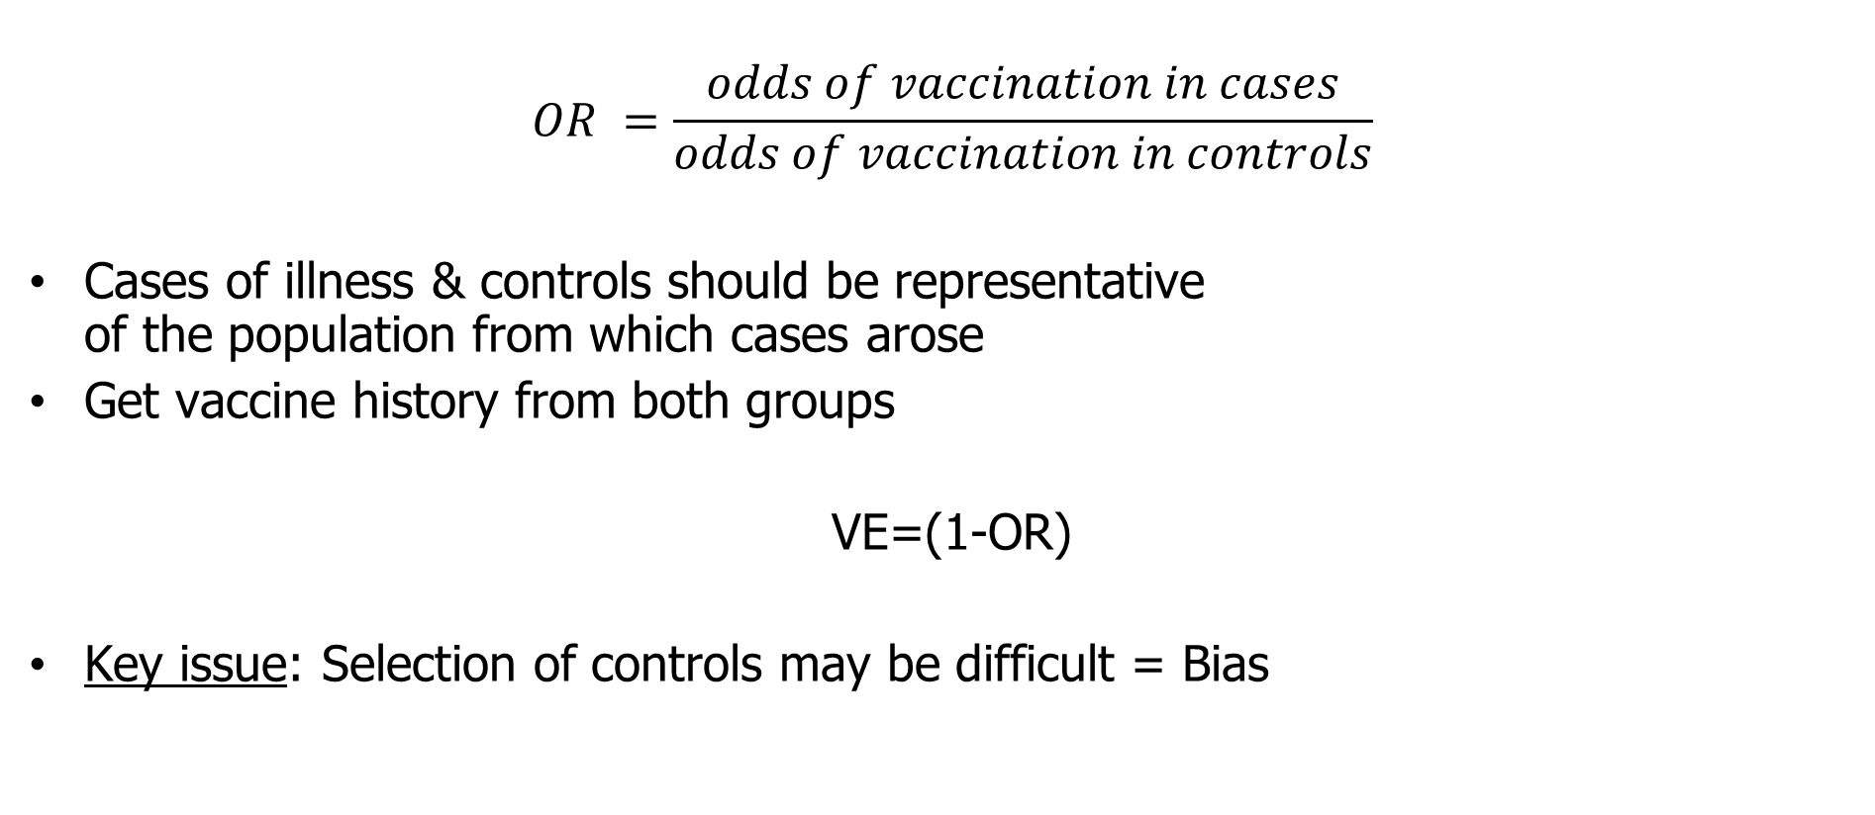
Case Control Design (and its variants)
$$OR =\frac{odds of vaccination in cases}{odds of vaccination in controls}$$
Cases of illness & controls should be representative
of the population from which cases arose
Get vaccine history from both groups
VE=(1-OR)
Key issue: Selection of controls may be difficult = Bias
Notes:
Case-control studies can also be used to estimate VE. - particularly for rare diseases and these are becoming increasingly used. The OR approximates to the RR for rare diseases.
Cases of illness and comparable controls are ascertained - then vaccine history is collected from both.
Great care needs to be taken to avoid confounding and bias and to select controls who are representative of the population from which the cases arose. Bear in mind for instance if controls are community based, then cases need to be selected which are representative of all cases in the community
It is best to select several controls per case, not only to increase power, but also so that there are an adequate number of vaccinated and unvaccinated non-cases.
Case-control studies can be designed in an unmatched fashion - adjusting for confounders in the analysis or a matched design can be used. This may be easier as in field conditions it is possible to select controls from the same general location as the case, in addition this usually adjusts for confounders such as socioeconomic status and access to immunisation services in the design.

Slide 30
Example - Case-control Study (Vazquez 2001 NEJM)
Varicella VE 1997-2000
  Cases Controls
Vaccinated 46 (a) 237 (b)
Unvaccinated 156 (c ) 152 (d)
OR = [a/c] / [b/d] = [46/156] / [237/152] = 0.19
VE = 1-OR
VE=1-0.19 = 0.81 (81%)

Slide 31
Example – Test negative case-control design
(Hardelid et al, Eurosurveillance 2011)
Pandemic Influenza VE
Sentinel GPs swab influenza like illness cases and send for laboratory confirmation
FLU + FLU-
Vaccinated 7 (a) 113 (b)
Unvaccinated 877 (c ) 2225 (d)
OR = [a/c] / [b/d] = [7/877] / [113/2225] = 0.16
VE = 1-OR
VE=1-0.16 = 0.84 (84%)
Key issue: needs a sensitive assay or cases become controls -> Bias

Slide 32
Note for trainers
Screening method provides a preliminary estimate of VE
Usually during an outbreak investigation among a vaccinated population or from routine national surveillance data
Provides reassurance that the proportion of vaccinated cases is what would have been expected given the vaccine uptake in the population or triggers further investigation

Slide 33
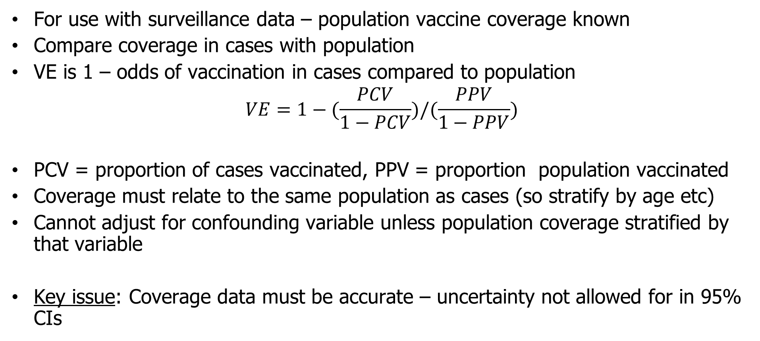
Screening Method
For use with surveillance data – population vaccine coverage known
Compare coverage in cases with population
VE is 1 – odds of vaccination in cases compared to population
$$VE=1−(\frac{PCV}{1−PCV})/(\frac{PPV}{1−PPV})$$
PCV = proportion of cases vaccinated, PPV = proportion population vaccinated
Coverage must relate to the same population as cases (so stratify by age etc)
Cannot adjust for confounding variable unless population coverage stratified by that variable
Key issue: Coverage data must be accurate – uncertainty not allowed for in 95% CIs
Notes:
Also known as case-population studies. This provides a preliminary estimate of VE usually during an outbreak investigation among a vaccinated population and provides reassurance that the proportion of vaccinated cases is what would have been expected given the vaccine uptake in the population.
Through a series of curves, the VE is estimated by comparing vaccine uptake amongst cases (PCV) with vaccine uptake in the population (PPV). Generally with higher population coverage, vaccine uptake also increases among cases.
In addition, it provides a poor estimate at the limits of the curve when the population coverage is either very high or very low.
The main limitations of this method are that it allows very little control of confounding - thus it is important to be sure that the cases are from the same population as the PPV data.
This is partially achieved by ensuring both PPV and PCV are from the same age groups.
However it does seem to have a role in the initial determination of a need for a further more methodologically rigorous study.

Slide 34
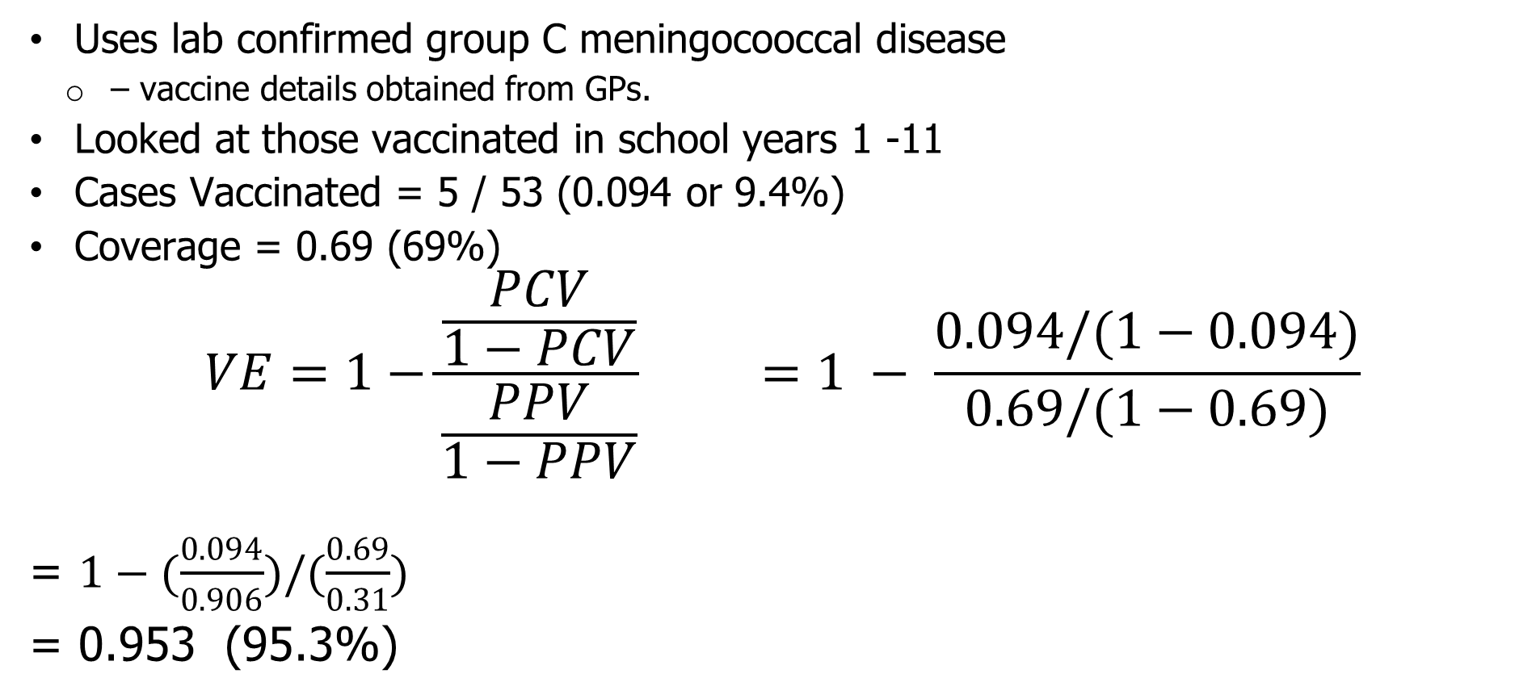
Screening Method to estimate VE for Meningococcal Conjugate Vaccine (2000-2002)
Uses lab confirmed group C meningocooccal disease
  – vaccine details obtained from GPs.
Looked at those vaccinated in school years 1 -11
Cases Vaccinated = 5 / 53 (0.094 or 9.4%)
Coverage = 0.69 (69%)
$$VE=1−\frac{\frac{PCV}{1−PCV}}{\frac{PPV}{1−PPV}} =1 − \frac{0.094/(1−0.094)}{0.69/(1−0.69)}$$
= $1−(\frac{0.094}{0.906})/(\frac{0.69}{0.31})$
= 0.953 (95.3%)

Slide 35
Note for trainers
Through a series of curves, VE is estimated by comparing PCV with PPV.
Generally with higher population coverage, vaccine uptake also increases among cases.
Give a specific example

Slide 36
Screening Method (properties)
Notes:
Through a series of curves, the VE is estimated by comparing vaccine uptake amongst cases (PCV) with vaccine uptake in the population (PPV). Generally with higher population coverage, vaccine uptake also increases among cases.
For example : if coverage (PPV) for measles vaccine was thought to be 90% and if 50% of cases in an outbreak had a history of vaccine (PCV) - VE is estimated at 90%. The investigator might conclude that efficacy was not a major problem in the outbreak.
However if PPV was 50%, and PCV was 40%, then estimated VE would be below 40% causing more concern.

Slide 37
Methodological issues

Slide 38
Methodological Issues
Case definition
Case ascertainment
Vaccine history
Comparability of vaccinated/unvaccinated groups

Slide 39
Methodological Issues - case definition (1)
Different endpoints may have different true VE:
Clinical disease
Hospitalised case (severe)
Carrier state
Notes:
The purpose of the study needs to be clearly defined and thus the case definition. What endpoint is of interest - is it protection against clinical disease, or carrier state or serological evidence of infection. Each may have different VE..

Slide 40
Methodological Issues - case definition (2)
Specificity and sensitivity of the case-definition
Specificity: case definition based only on clinical criteria may result in
false-positive diagnoses
  ARV increases relatively more than ARU
  artificial reduction in VE
Sensitivity: case definition with low sensitivity usually only lowers precision (except test-negative case control design)
  Differential sensitivity: If more sensitive in the unvaccinated then VE estimate will be higher than true VE.
Notes:
Ideally the case definitions should be both sensitive and specific, but specificity is a more crucial factor than sensitivity.
However if the case definition is non-specific, then background illness may be misclassified as cases. If these false positives distribute equally between vaccinated and unvaccinated, then the AR will rise disproportionately in vaccinated compared to the unvaccinated. Remembering the equation results in an increase in RR - thus resulting in a falsely low estimate of VE.
Sensitivity is important to gain a more precise estimate. Low sensitivity lowers the power of the study, but does not alter the point estimate, providing the sensitivity is the same for vaccinees and non-vaccinees (which we deal with under case-ascertainment) - as you lose both vacc and unvacc cases.

Slide 41
Methodological Issues - case definition (3)
Changes in mumps vaccine effectiveness
Kim Farley et al 1985 AJE
 | Diagnosis by school nurse
ARV | 18% (12/67)
ARU | 28% (77/272)
VE | 37%
Notes:
This example shows the effect of changes in the specificity of a case definition for mumps during an outbreak investigation of mumps vaccine efficacy.
Initially cases were defined by the school nurse on the basis of parents notes- resulting in an ARV of 18% and ARU of 28% and thus a VE of 37%.

Slide 42
Note for trainers
For following slide – ask group to explain why could VE be so low (you might ask people to do it in pairs)
Then parents were interviewed and a clinical case definition was used which was more specific. Then relatively more cases were excluded from the vaccinated group resulting in an increase in the estimated VE

Slide 43
Methodological Issues - case definition (3)
Changes in mumps vaccine effectiveness
Kim Farley et al 1985 AJE
 | Diagnosis by school nurse | Diagnosis of parotitis
ARV | 18% (12/67) | 12% (8/67)
ARU | 28% (77/272) | 25% (68/272)
VE | 37% | 52%
Notes:
However when parents were interviewed and a clinical case definition was used which was more specific (parotitis for more than 2 days) - then relatively more cases were excluded from the vaccinated group resulting in an increase in the estimated VE to 52% (more accurate).

Slide 44
Note for trainers
Case-finding depends on many factors including the nature and incidence of the disease, type of study, the degree to which cases have access to medical services and the quality of medical records.
Main aim is to avoid differential case finding according to vaccination status

Slide 45
Methodological Issues - case ascertainment (1)
Case ascertainment must be independent of vaccination history…..
Vaccinated and unvaccinated populations may not have equal access to health care services;
Two types of case finding used:
Population based
  Avoids differential use of health care services
  Useful for common, less serious diseases
  Use in local outbreaks
Health care provider
  Good for rare, severe diseases e.G. Meningitis
  Provides laboratory confirmation (increases specificity)
Notes:
The design of case-finding depends on many factors including the nature and incidence of the disease, the type of study, the degree to which cases have access to medical services and the quality of medical records. The main aim is to avoid differential case finding according to vaccination status.
There are two main alternatives: population based case finding and health care provider based case finding.
The former is usually preferable especially for common diseases such as MMR for which patients frequently do not seek medical care. In addition provider based systems may tend to selectively report those with good access to medical services such as vaccination.
However provider based case finding may be more practical for rare severe diseases eg bacterial meningitis, where cases are usually hospitalised. In addition health care facilities often provide lab confirmation a and thus improve the specificity of case definition.

Slide 46
Methodological Issues - case ascertainment (2)
Effect of complete case finding on mumps VE
Kim Farley et al 1985 AJE
 | Diagnosis of parotitis
ARV | 12% (8/67)
ARU | 25% (68/272)
VE | 52%
Notes:
This example shows the impact of an alteration in the method of case finding during the same outbreak of mumps. With case finding initially through the school nurse who produced a list of cases. 8 vaccinated cases and 68 UV cases were found, resulting in an estimated VE of 52%.

Slide 47
Note for trainers
Ask the group to explain what has happened.
Using a population based survey of approaching all parents to identify cases, the survey recognised a large number of previously unidentified cases - 8 vaccinated and 97 unvaccinated so particularly amongst the unvaccinated cohort.
Resulted in an increase in the calculated VE to 64%.

Slide 48
Methodological Issues - case ascertainment (3)
Effect of complete case finding on mumps VE
Kim Farley et al 1985 AJE
 | Diagnosis of parotitis | Case finding among parents
ARV | 12% (8/67) | 13% (9/67)
ARU | 25% (68/272) | 36% (97/272)
VE | 52% | 64%
Notes:
Using a population based survey of approaching all parents to identify cases, the survey recognised a large number of previously unidentified cases - 8 vaccinated and 97 unvaccinated so particularly amongst the unvaccinated cohort. This resulted in an increase in the calculated VE to 64%.

Slide 49
Methodological Issues - vaccine history ascertainment
Avoid misclassification of vaccination status
  Will bias VE to be lower than true VE e.G. Due to recall bias
Equal effort to confirm vaccination status amongst cases and non-cases
  Vaccination histories should be documented using GP, clinic or computer records
    Parental recall - overestimate vaccine coverage
    Written records - underestimate vaccine coverage
  Individuals with missing vaccination records should be excluded from the analysis

Slide 50
Methodological Issues - multiple doses
May need >1 dose of vaccine for full protection
Partial vaccination may afford some protection
  If classified partially vaccinated as unvaccinated - decreased ARU
  If classified partially vaccinated as vaccinated - increased ARV
If require effectiveness of full course of vaccination – need to exclude partially vaccinated cases
Notes:
If multiple doses of vaccine are needed to acquire full protection.
Partial vaccination may afford some protection
To calculate the VE of the complete scheme, this should be compared to those who have received no vaccine with those who have received one or two doses excluded.
However, it is also possible to calculate the VE of 1 dose vs. none or two doses vs. none, and thus estimate the protection afforded by a partial series.

Slide 51
Methodological Issues – confounding
Both exposure to infection and vaccination coverage may vary by age, location, socio-economic factors --> confounding.
Controlling for age is important as disease incidence and vaccine coverage are often both age-dependent.
Potential solutions:
  Stratified analysis
  Multivariable regression analysis – logistic regression
Notes:
The ideal observational study would involve V and UV groups whose only difference was in regards to vaccination status - however post-licensure trials mean that UV and V can be dissimilar in several ways.
The risk of infection during the outbreak should be the same for UV and V, however if the UV come from a population cluster with low coverage then the infection exposure may be higher than where population more highly vaccinated and thus the indirect effect of vaccination (herd immunity effect) is different. Often an assumption is made of a randomly mixing population of vaccinated and unvaccinated individuals (although estimates of this different indirect effect can be made from random effects models).
Likewise the susceptibility to infection (in particular previous exposure to infection) should be the same for UV and V (except vaccine which should be randomly administered), otherwise estimates of VE can be distorted.

Slide 52
Methodological Issues – past exposure
If, prior to a study (e.g. outbreak), unvaccinated individuals have been exposed to the disease more than vaccinated individuals then they may have increased natural immunity.
This will result in a biased lower VE unless those with evidence of past disease are excluded.
Notes:
This is crucial in defining our denominator population. There should be similar susceptibility of the vaccinated and unvaccinated groups except in regard of vaccination status.
This is a reflection of the exposure to infection prior to the investigation. IF before the outbreak the UV had been exposed to disease more than the vaccinated, then susceptibility may be much lower in the UV group compared to the V group, resulting in a lower than expected AR in the UV, a larger RR and thus a falsely low VE.
Thus it must be decided whether to obtain histories of those with prior disease and to include them or to ignore them totally. Models have estimated that ignoring prior disease status can give a VE estimate up to 10% lower than true VE for measles vaccine even when previous exposure was high.
We then touch on case definition again. Many infections can be subclinical - for example 50% of rubella cases. If the proportion of subclinical infections is the same regardless of vaccination status, VE against clinical disease should the same as the VE against infection. However, if there is an alteration in the host response by vaccination, so the proportion of subclinical infections is higher in vaccinated compared to unvaccinated,thus resulting in a lower than expected AR for disease in vaccinated and thus a smaller RR. The VE for disease will be higher than the protection against infection. Usually though we are more interested in protection against disease rather than protection against infection.

Slide 53
Methodological Issues – differential exposure
During the study exposure should be similar in vaccinated and unvaccinated groups.
  If less exposure in vaccinated then you will over estimate VE.
Need to address this is the design (e.g. house hold contact) or measure confounders

Slide 54
Interpretation of VE
Individual and herd effects
Primary and secondary vaccine failure
Risk factors for vaccine failure

Slide 55
Herd immunity

Slide 56
Individual and group effects
Individuals are vaccinated primarily for the direct protection conferred to them by the vaccine.
However, vaccination on a large scale may have group effects.
Individuals may escape infection though they are not individually protected: this is the effect of herd immunity.
Conversely, natural boosting of vaccine protection may no longer take place (e.g. potential impact of Varicella vaccine on Zoster)

Slide 57
Note for trainers
Next slide showing the indirect effect of a vaccine programme with a reduction in disease incidence in the older unvaccinated cohorts = herd immunity effect..

Slide 58
Impact of MenC conjugate vaccine and MenC disease
Notes:
Vaccine introduced 1999-2000 with catch-up to age 18

Slide 59
Primary and secondary vaccine failure

Slide 60
Primary and secondary vaccine failure
Primary vaccine failure
  Failure to seroconvert after vaccination
Secondary vaccine failure
  Waning immunity after seroconversion
Study design
  Calculate VE for different time frames after vaccination
  HIB VE with 2 years of vaccination of 1-4 year olds = 97%, but drops to 72% after 2 years
  Caution – apparent waning could be due to how the vaccine protects
  ALL or NOTHING – either seroconvert or you don’t
  LEAKY – just reduces your chance of infection or disease at each exposure
Notes:
It is also possible to estimate how much VE declines with time after vaccination, by calculating the VE for groups with different time frames after having received their scheduled vaccine.

Slide 61
Risk factors for vaccine failure
Studies of risk factors for vaccine failure compare vaccinated cases and non-cases
Particularly relevant:
  In outbreak investigations;
  When vaccine coverage is very high

Slide 62
VE as tool for VPD surveillance
Monitoring vaccine effectiveness is an integral part of epidemiological surveillance
Vaccine effectiveness can be estimated from surveillance and coverage data, using the screening method
Surveillance data may be used on its own if test negatives or non vaccine types can act as controls
Such estimates complement those from outbreak investigations and clinical trials
Interpretation should take into account possible biases

Slide 63
References
Orenstein W.A., Bernier R.H. & Hinman A.R. Assessing vaccine efficacy in the field. Epidemiologic Reviews, 1988: 10: 212-241.
Farrington C.P. (1993). Estimation of vaccine effectiveness using the screening method. International Journal of Epidemiology, 1993: 22: 742-746.
Rodrigues LC. and Smith PG. Use of the Case-Control Approach in Vaccine Evaluation: Efficacy and Adverse Effects. Epidemiological Reviews 1999:21:56-72.
Halloran MEH, Longini IML, Struchiner CJ. Design and Interpretation of Vaccine Field Studies. Epidemiological Reviews 1999:21:73-87.
Valenciano M, Kissling E, Ciancio BC, Moren A. Study designs for timely estimation of influenza vaccine effectiveness using European sentinel practitioner networks. Vaccine. 2010 Oct 28;28(46):7381-8. Epub 2010 Sep 17.
Notes:
Facilitator notes:

Slide 64
Acknowledgements
The creation of this training material was commissioned in 2012 by ECDC to the consortium of experts with the direct involvement of Hanna Nohynek, Richard Pebody and Nick Andrews
The revision and update of this training material was commissioned in 2017 by ECDC to Transmissible with the direct involvement of Pawel Stefanoff and Arnold Bosman
Notes:
Facilitator notes:

