Slide 1
Exercise Philadelphia
Reviewing, rehearsing and enhancing outbreak response for Legionnaires’ disease
July 2023

Slide 2
Aim and objectives
The aim of this off-the-shelf exercise is to aid EU Member States (MS), European Economic Area (EEA) and Enlargement countries to review, rehearse and enhance their preparedness and response to an outbreak of Legionnaires’ disease.
Participants will work towards the following objectives:
To develop a shared understanding of risk and escalation triggers.
To review outbreak surveillance and control arrangements on the national, and/or regional and/or local levels.
To consider interdependencies with national, regional and local partners.
To review communication strategies and platforms used in an outbreak of Legionnaires’ disease, including information exchange with international partners.

Slide 3
Exercise Programme
Time | Agenda item
09:00-09:15 | Exercise introduction, aim and objectives
09:15-10:00 | Session 1
10:00-10:45 | Session 2
10:45-11:00 | Coffee break
11:00-11:45 | Session 3
11:45-12:00 | Hot debrief, next steps
Notes:
Adjust this agenda to your own exercise needs

Slide 4
How to participate
Use your organisation’s existing plans and processes to respond to the scenario
Record your actions and responses to questions in the participant response handbook
Interact with other participants
Treat this exercise as a safe learning environment to question plans, resources, and identify areas for development
IMPORTANT! Don’t fight the scenario! Accept artificialities and limitations
Notes:
Add whether groups should appoint chair/notetaker depending on your requirements. If you are conducting this exercise virtually, also add information on expected virtual conduct.
Introduce your facilitator here if you are using one.

Slide 5
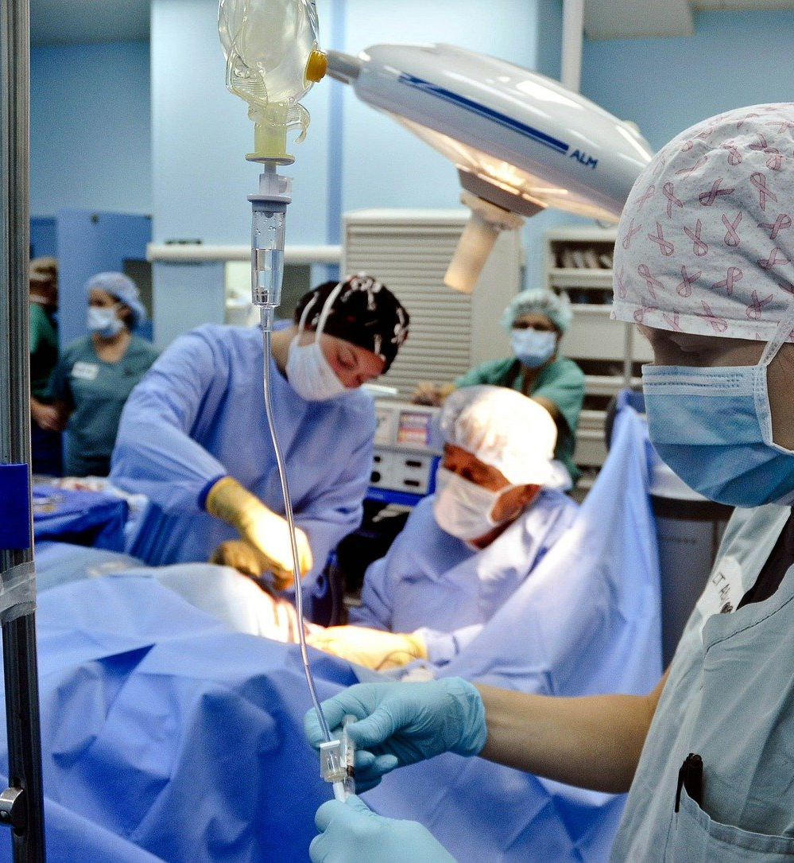
Scenario outline Module 1: Hospital
Exercise date: 7 May, Anytown
You are asked to investigate and respond to an ongoing outbreak of Legionnaires’ disease that may be associated to Anytown Hospital.
Anytown is a medium-sized town in an EU country. Not many outbreaks of Legionnaires’ disease have taken place here in the recent years. Expect a lot of public and media interest.
Notes:
Present the scenario outline for your chosen scenario.

Slide 6
Scenario outline Module 2: Travel
Exercise date: 28 June, Anytown
You are asked to investigate and respond to an ongoing outbreak of Legionnaires’ disease that may be associated to a local hotel.
Anytown is a medium-sized town in an EU country. Not many outbreaks of Legionnaires’ disease have taken place here in the recent years. Expect a lot of public and media interest.
Notes:
Present the scenario outline for your chosen scenario.

Slide 7
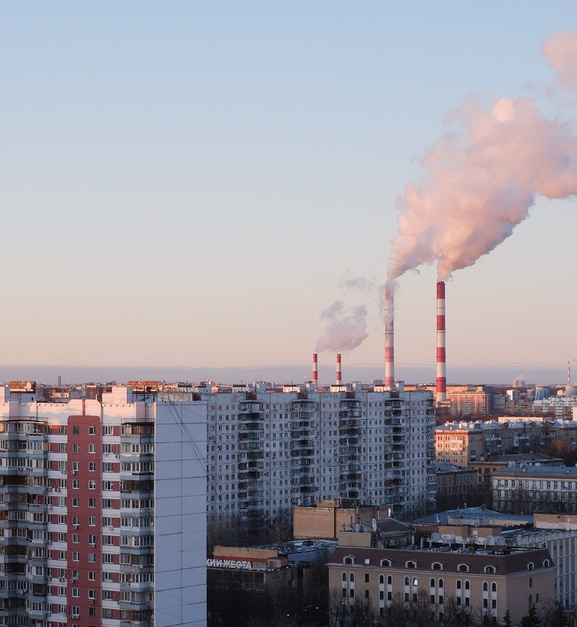
Scenario outline Module 3: Community
Exercise date: 4 August, Anytown
You are asked to investigate and respond to an ongoing outbreak of Legionnaires’ disease, the source of which is still unknown.
Anytown is a medium-sized town in an EU country. Not many outbreaks of Legionnaires’ disease have taken place here in the recent years. Expect a lot of public and media interest.
Notes:
Present the scenario outline for your chosen scenario.

Slide 8
Session 1
Notes:
These slides can be used as a background when exercise play is ongoing.

Slide 9
Session 2
Notes:
These slides can be used as a background when exercise play is ongoing.

Slide 10
Session 3
Notes:
These slides can be used as a background when exercise play is ongoing.

Slide 11
Hot debrief
What went well?
What can be improved?
What recommendations can we make?
What actions can we take forward?

