Slide 1
Principles of outbreak investigation in acute care hospitals
Investigation and control of outbreaks of healthcare-associated infections
Agnes Hajdu

Slide 2
Why to focus on acute care hospitals?
Acute care hospitals are complex settings with conditions that facilitate the transmission of pathogens leading to healthcare-associated infections (HAI).
Vulnerable patients in close proximity
Frequent contact with healthcare workers (HCWs)
Invasive procedures and devices
Special techniques or equipment
Contamination of the environment
Multidrug-resistant organisms (MDRO)
Outbreaks may cause significant disruption and impact patient morbidity and mortality

Slide 3
Healthcare settings where outbreaks can occur
Inpatient and outpatient settings including:
hospitals (primary, secondary, tertiary, specialised)
long-term care facilities, nursing homes, rehabilitation centers
dialysis centers, ambulatory surgery centers, cancer treatment centers, dental clinics, physician offices
laboratories
and any other facility which provides health care or diagnostic services to individuals

Slide 4
Types of outbreaks in heathcare settings
„Non-healthcare-specific” outbreaks
More common
Occur in community settings, too
Respiratory, e.g. influenza, SARS-CoV-2, RSV, measles
Legionella pneumophila
Enteric, e.g norovirus, rotavirus
Some may be „seasonal”
Cases among HCWs as well
Often higher case counts (leading to ward closures), but usually no or few deaths
„Healthcare-specific” outbreaks
Less common
Occur mainly or only in healthcare/hospital settings
E.g. outbreak of bloodstream infections in an intensive care unit (ICU), outbreak of surgical site infections
Often caused by MDRO (e.g. MRSA, ESBL-E, CPE) or „nosocomial organism” (e.g. Acinetobacter spp, P. aeruginosa)
Usually few cases, but case fatality may be high

Slide 5
What is an „outbreak”?
Two or more linked cases of the same infection.
The observed number of cases (infections or isolates) exceeds the baseline number.
A single case of infection caused by a significant/rare pathogen (e.g. healthcare-associated Legionellosis).
Beware of the possibility of outbreaks that do not present as an obvious cluster of similar cases.

Slide 6
When to investigate a HAI outbreak and who are responsible for it?
An initial investigation is always necessary to confirm the outbreak and implement control measures in a timely manner.
Local infection prevention and control (IPC) staff take the lead in collaboration with the medical and nursing staff of the unit(s) affected and microbiologists from the local (or reference) laboratory.
Others possibly involved, depending on the context of the outbreak and legal regulations:
Technical/maintainance staff (e.g. water supply, air/ventilation)
Enviromental cleaning and disinfection staff
Pharmacists
Occupational health staff
Management / leadership
Local public health authority
Good to have an outbreak investigation plan (e.g. local standard operating procedure) at hand.

Slide 7
When to investigate a HAI outbreak and who are responsible for it? (continued)
A full investigation is necessary if:
New cases occur despite control measures implemented
Large health impact (severe cases, unusual manifestation, high case fatality, newly identified strain or antimicrobial resistance mechanism)
Suspicion of instrinsic product contamination
Large number of cases
Multiple wards affected
Involvement of the regional/national public health authority or public health institute:
Investigation of complex, hard-to-solve outbreaks
Outbreaks involving multiple healthcare facilities in the region/country
Advanced epidemiological and/or microbiological support
Communication in high-profile outbreaks
Educational/training purposes (e.g. FETP/EPIET/EUPHEM fellow)

Slide 8
Basic principles
Infectious agent
Susceptible host
Reservoir
“Know your enemy, know his sword.”
Miyamoto Musashi
A Book of Five Rings:
The Classic Guide to Strategy
Knowledge on the infectious agent and its clinical manifestations, mode(s) of transmission, common reservoirs (if relevant), potential sources, method of detection guides the approach of the investigation
Professional experience + scientific literature/handbooks
Multidisciplinary teamwork
Common sense and open mind
Systematic, „stepwise” approach to the investigation
Chain of infection
Portal of entry
Portal of exit
Mode of transmission

Slide 9
Knowledge on the infectious agent - example
Infectious agent, type of infection | Possible sites of colonisation / common reservoirs | Potential sources / risk factors / sites associated with outbreaks | Method of detection | Other information
Acinetobacter spp. Gram negative, opportunistic pathogen Bloodstream infection, respiratory tract infection, pneumonia, wound infection | Human: wound, genito-urinary tract, perirectal area Environmental: aquatic environments, biofilms, medical devices | Respiratory equipment, mechanical ventilation, indwelling catheters Burns, trauma, prior surgery Water sources (taps, sinks, wastewater) | Human: Microbiological cultures Environmental: Surface swabs and culture of potentially implicated items or devices | It can contaminate the hospital environment extensively and it can be very difficult to eradicate. High-risk wards: intensive care units, burn units, wards with immuno-compromised population

Slide 10
Steps of an outbreak investigation
In a multidisciplinary manner:
Conduct outbreak surveillance and detection.
Confirm the outbreak, and assess the health impact.
Establish a case definition, mechanisms for case finding and count cases.
Conduct descriptive epidemiological and other preliminary investigations.
Where relevant, conduct contact tracing, environmental investigations, testing of healthcare workers.
If necessary, undertake an analytical study to identify the cause of the outbreak.
Document and communicate findings.
Continuously implement and evaluate IPC measures.

Slide 11
1. Suspicion of a HAI outbreak
Increased occurance of cases with the same symptoms/infection in the same unit noticed by
Clinical staff (physicians or nurses), or
Consultant infectious disease specialist, or
IPC nurse responsible for HAI surveillance.
Increased number of isolates belonging to the same species/genotype noticed by
IPC staff through routine review of microbiological results, or
Local (or reference) laboratory staff, alerting ward clinicians and/or IPC staff and/or the public health authority.

Slide 12
Examples
Six inpatients and 2 nurses are presenting with mild cough and running nose in a rehabilitation ward. Four cases test positive for SARS-CoV-2.
In 2 adjacent internal medicine wards, several patients on a cholecystitis diet develop diarrhoea. Microbiological results are pending.
4 cases of post-operative endophthalmitis are admitted to a hospital. Rumour has it that they underwent cataract surgery in the same outpatient centre the day before.
In a neonatal intensive care unit (NICU), ESBL E. coli colonisation is found in a screening sample of a preterm baby. The National Reference Laboratory (NRL) receives the isolate and confirms that it’s the same strain that caused a large outbreak in the same NICU 2 months before.
In an adult ICU, 3 mechanically ventillated patients present with a fulminant bloodstream infection caused by K. pneumoniae within a month. All cases are fatal.

Slide 13
2. Confirming a suspected outbreak
Verify diagnosis
Confirmatory tests, clinical evaluation, if needed
Rare pathogen → double checking with the microbiologist, true pathogen vs contamination, pseudo-outbreak
Review of historical/baseline data
Consider outbreaks ongoing in the community
On-site visit(s) in the unit(s) affected by the local IPC staff
Collection of information and assessment of the situation as whole:
Discussion with medical and nursing staff (e.g. routines, protocols, possible errors), observation of procedures
Overview of presumed cases (as per a first, „interim” case definition)
Assessing possible relationship between cases (e.g. same room, similar equipment or device used)
Inspection of hygiene conditions, ward structure, staffing levels

Slide 14
3. Primary control measures and reporting
Control measures to stop transmission depending on the context of the outbreak, e.g.:
Initiate transmission-based precautions
Cohort or isolate symptomatic patients and all lab-confirmed cases
Reinforce compliance with IPC guidelines among staff
Adjust practices and processes, as necessary (e.g. outbreak of C. difficile infection → handwashing of HCWs required, environmental disinfection with sporocial agent)
Ask the laboratory early on to save isolates for microbiological typing
Additional action, as necessary (contact tracing, screening, enhanced surveillance etc.)
Communication:
Document the events and main findings in a log file / short report
Report the outbreak to the public health authority according to legal regulations

Slide 15
4. Reviewing the situation
The existence of an outbreak is ruled out (=cluster of unrelated events).
The existence of an outbreak is confirmed, but its health impact is low and it can be controlled by generic IPC measures.
The existence of an outbreak is confirmed, and its health impact is high, or it cannot be controlled by generic IPC measures (new cases are occuring), or the setting is high-risk (e.g. ICU, NICU, transplantation unit, dialysis).

Slide 16
5. Establishing a formal case definition
Establish a formal case definition to systematically identify cases that are part of the outbreak:
Person, place and time criteria
Clinical, epidemiological and laboratory criteria
Confirmed, probable, possible case categories
The case definition should be sensitive enough to capture any potential cases (reflecting the true extent of the outbreak) and specific enough to ensure that case counts are not „inflated” (otherwise investigation of epidemiological links may be biased).
The case definition may change over time (sensitive, including the pathogen identified → specific, including genotype of the outbreak strain)
Prospective +/- retrospective case finding

Slide 17
Example
Confirmed case: An inpatient admitted to or present on the ICU in Hospital „A” between 1 and 15 January with any type of microbiological sample positive for Pantoea agglomerans during the patient’s ICU stay.
Probable case: An inpatient admitted to or present on the ICU in Hospital „A” between 1 and 15 January, and who developed fulminant septic shock with cardiovascular collapse, and no sample was taken or sample was negative in the above period.
Possible case: An inpatient admitted to or present on the ICU in Hospital „A” between 1 and 15 January, and who developed signs and symptoms of infection (e.g. increased procalcitonin/WBC/CRP levels, hypotension, fever or increased temperature), and no sample was taken or sample was negative in the above period.

Slide 18
6. Organizing descriptive case data in a „line list” (exposure data collected tailored to the context of a given outbreak)
Demographic and outcome data:
Patient's name
Patient ID
Age
Sex
Case status (confirmed, probable, possible)
Date of hospital admission
Location data (room#, bed#)
Transfer between wards + dates
Infection/colonisation
Onset of symptoms
Clinical manifestation
Outcome (alive/died)
Date of discharge/death
Risk factors/exposures before onset:
Medications
Surgery since admission + date
Endoscopy since admission + date
Invasive device use + dates
Information on attending medical, nursing, surgical staff
Laboratory results
Pathogen(s)
Typing results (e.g., PFGE, genotype)
Date of specimen collection
Date reported by laboratory

Slide 19
6. Organizing descriptive case data in a „line list” (exposure data collected tailored to the context of a given outbreak)
Demographic and outcome data:
Patient's name
Patient ID
Age
Sex
Case status (confirmed, probable, possible)
Date of hospital admission
Location data (room#, bed#)
Transfer between wards + dates
Infection/colonisation
Onset of symptoms
Clinical manifestation
Outcome (alive/died)
Date of discharge/death
Risk factors/exposures before onset:
Medications
Surgery since admission + date
Endoscopy since admission + date
Invasive device use + dates
Information on attending medical, nursing, surgical staff
Laboratory results
Pathogen(s)
Typing results (e.g., PFGE, genotype)
Date of specimen collection
Date reported by laboratory
CDC, Healthcare-Associated Infection (HAI) Outbreak Investigation Toolkit https://www.cdc.gov/hai/outbreaks/outbreaktoolkit.html

Slide 20
Approaches to guide data collection
3P
5W
Period (Time) – date of admission, discharge/transfer/death, sampling, onset of symptoms for each case, epidemic curve
Place – where did the infections occur (wards, departments, hospital site affected)
Person – confirmed / probable / possible cases, patient or HCW, persons exposed, type of infection and symptoms, severity, outcome
What (type of infection, pathogen)
Who (case characteristics)
Where (ward / department)
When (outbreak period, epidemic curve)
Why/how (cause, risk factors, reservoirs, mode/vehicle of transmission)
Sources of information: medical and nursing records, fever charts, microbiology reports, operating room notes, therapy and procedure logs, pharmacy records, radiology records, pathology records.

Slide 21
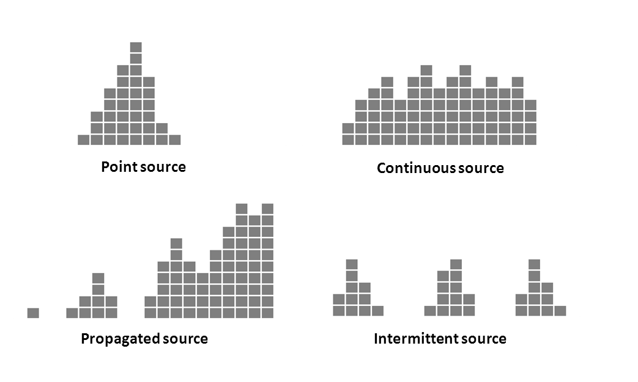
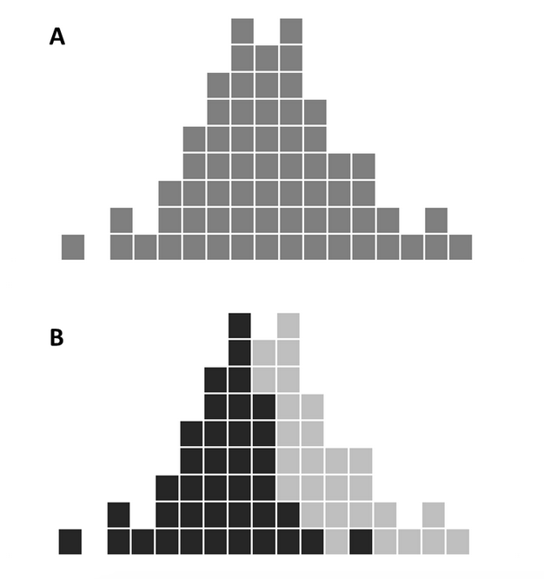
7. Constructing an epidemic curve (cases plotted over time)
Outbreak cases overall
Cases on ward 1 and ward 2
Information on the outbreak pattern, probable exposure period and forward trajectory.

Slide 22
Example: Epicurve
Fabricci M. et al. A urokinase-associated outbreak of Ralstonia mannitolilytica bloodstream infections in haemodialysis patients in north-eastern Italy, January to April 2023. Euro Surveill. 2023;28(28):pii=2300328.

Slide 23
Example: Patient location / floor plan
Haidong W. et al.
Identifying index (source) patient location of SARS transmission in a hospital ward. HVAC&R Research, 2012, 18:4, 616-625.

Slide 24
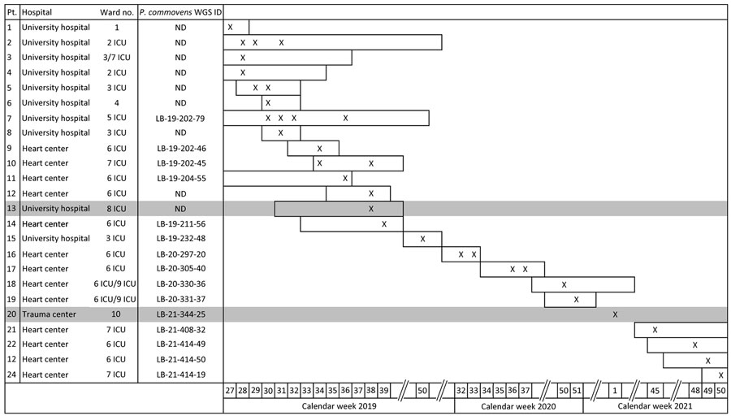
Example: Timeline of cases
Kruis T. et al. Outbreak of Pandoraea commovens among non–cystic fibrosis intensive care patients, Germany, 2019–2021.
Emerg Infect Dis. 2023 Nov. (early release)
X symbols indicate calendar weeks with detection of P. commovens.; horizontal bars in timelines indicate length of stay. ICU, intensive care unit; ND not done, WGS ID, whole-genome sequencing identification number

Slide 25
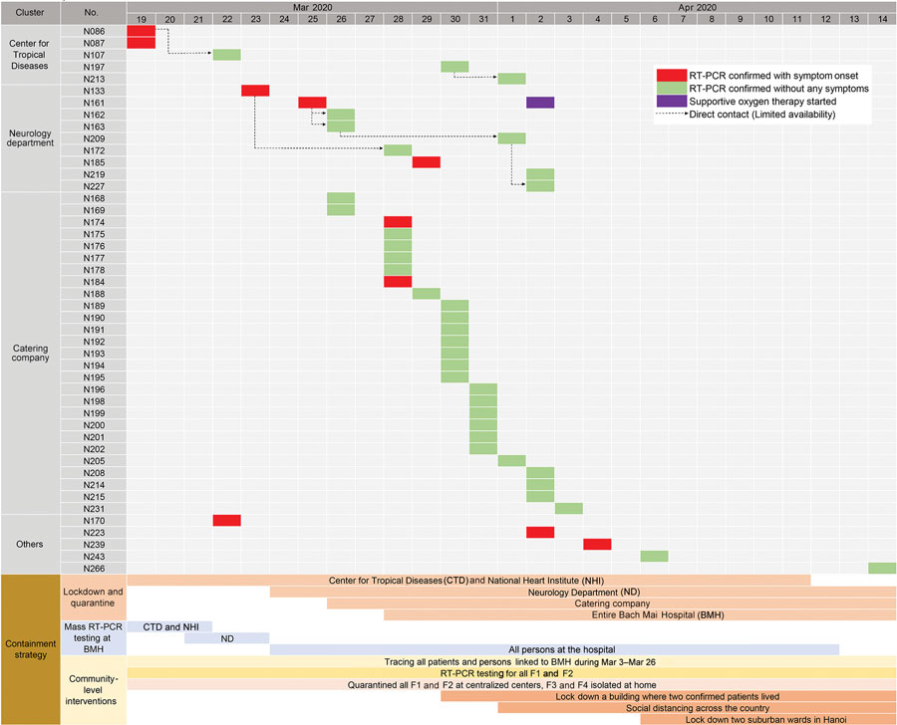
Example: Timeline of cases and control measures
Duy C. et al.
Nosocomial Coronavirus Disease Outbreak Containment, Hanoi, Vietnam, March–April 2020.
Emerging Infectious Diseases. 2021;27(1):10-17.

Slide 26
8. Microbiological & environmental investigations
Should be considered right at the beginning of an outbreak.
Microbiological investigations may include testing of contacts, enhanced screening of patients, screening of HCWs, typing of isolates (classical and sequence-based methods), additional testing (e.g. disinfectant-resistance).
Environmental sampling strategy: surfaces/devices/medications designated for sampling should take into account the infectious agent's characteristics and descriptive epidemiological data available.
Interpretation issues with positive or negative environmental findings, e.g.:
Results may be inconclusive if cleaning and disinfection had taken place as part of the immediate control measures and surface samples were taken only afterwards.
False negative water samples due to, e.g.
biofilm-forming bacteria entering the water only intermittently
counter-effect of chlorine in drinking water
Positive samples are not necessarily evidence of transmission from a particular source.

Slide 27
9. Establishing a hypothesis (or modifying the preliminary hypothesis)
Based on the on-site inspection, epidemiological, microbiological and environmental results, a hypothesis should be formed on the source of the outbreak, mode and/or vehicle of transmission and/or practice that might have caused the outbreak.
Brief examples:
S. aureus infections over a longer period of time among neonates: contact transmission linked to a S. aureus carrier identified among HCWs.
Respiratory infections caused by P. aeruginosa or Acinetobacter spp. in the ICU due to a persistent environmental reservoir and poor hand hygiene of HCWs.
Aspergillosis in a hematology unit: linked to construction/demolition work in nearby units, transmission through the ventilation system.
Common vehicle with microbiologically confirmed intrinsic contamination (e.g. intravenous immunoglobulin, peritoneal solution) or extrinsic contamination (e.g. multidose-vials, endoscope).

Slide 28
10. Deciding if testing of hypothesis is needed
Conducting an analytical study is recommended if:
Results are expected to add to what is already known about the cause of the outbreak or contribute to the control measures.
Technical-methodological and statistical support is available.
Case and control numbers are high enough for a meaningful statistical analysis.
Sufficiently detailed exposure data is available or can be collected.

Slide 29
11. Conducting an analytical study
Two main analytical epidemiological methods:
Cohort studies:
Comparing the incidence of infection among those who were exposed and those who were not exposed)
Calculation of relative risk (RR) for each exposure
Interpretation of results (example): Patients operated by Team „X” were significantly more likely to develop a surgical site infection caused by MRSA than patients operated by the comparator team (Team „Y”).
Case-control studies:
Assessing exposures among cases and controls, and comparing the odds of exposure)
Calculation of odds ratio (OR) for each exposure
Interpretation of results (example): Cases of bloodstream infection caused by Serratia marcescens had significantly higher odds to be treated with infusion solution „Q” compared to controls.

Slide 30
12. Implementing control strategies, evaluation
Ideally: rapid, (cost-)effective and efficient measures
Generic and, ideally, targeted control measures based on all available findings
Breaking the chain of transmission in the context of a given outbreak through, e.g. improved hand hygiene, partial or full closure of affected wards or operating room, cohorting or isolation of case patients, enhanced environmental cleaning and disinfection, elimination of contaminated vehicles, product recall, changes in disinfectant used etc.
Updating practices and protocols, providing training to HCWs
Communication of findings in internal outbreak report structured along the steps of the outbreak investigation, external bulletin and/or scientific article
Evaluation of the investigation
Personal and institutional lessons learned

Slide 31
In summary
Most HAI outbreaks are solved through
on-site observation of key activities of HCWs (e.g. preparation of medicines, hand hygiene compliance, vascular access care, equipment reprocessing)
identification of undocumented practices, deviations from protocols
discussion of procedural issues with medical, nursing and other (e.g. cleaning) staff
descriptive data
Microbiological evidence and observations of IPC breaches that are known to be associated with transmission are often sufficient to recommend and implement control measures.
Analytical studies are needed in case they are expected to add value to the investigation, numbers of cases and controls are sufficient for a valid statistical analysis, and there is methodological and statistical support.

Slide 32
References and useful resources
Oxford Specialist Handbook of Infectious Disease Epidemiology. Eds: Abubakar I., Stagg H.R., Cohen T., Rodrigues L.C.
Sood G, Perl TM. Outbreaks in Health Care Settings. Infect Dis Clin North Am. 2016 Sep;30(3):661-87. doi: 10.1016/j.idc.2016.04.003.
Bryan E. Christensen, Ryan P. Fagan. The CDC Field Epidemiology Manual. Chapter on Healthcare Settings. https://www.cdc.gov/eis/field-epi-manual/chapters/Healthcare-Settings.html
Charité – Universitätsmedizin Berlin, Worldwide Database for Nosocomial Outbreaks https://www.outbreak-database.com
CDC, Healthcare-Associated Infection (HAI) Outbreak Investigation Toolkit https://www.cdc.gov/hai/outbreaks/outbreaktoolkit.html

Slide 33
Acknowledgements The creation of this training material was commissioned by ECDC to Agnes Hajdu

